Slide 1
Cyber Fraud App Detection and Prevention Using Machine Learning

Slide 2
ABSTRACT:
Cyber fraud detection and prevention using machine learning (ML) is an advanced approach to safeguarding digital transactions and data integrity.
Machine learning algorithms, including supervised and unsupervised learning techniques, are leveraged to analyze vast amounts of data, identify patterns, and detect anomalies indicative of fraudulent activities.
By continuously learning from new data, ML models can adapt to evolving cyber threats and provide real-time fraud detection, reducing false positives and enhancing accuracy.
This approach not only improves the efficiency and effectiveness of fraud detection systems but also helps in predicting potential frauds, thereby enabling proactive measures to prevent cyber attacks.

Slide 3
INTRODUCTION
In the digital age, cyber fraud has become a pervasive threat, targeting individuals, businesses, and institutions alike. Traditional methods of detecting and preventing fraud are often inadequate against sophisticated and constantly evolving cyber attacks.
This is where machine learning (ML) steps in as a game-changer. By leveraging advanced algorithms and data analysis techniques, ML can identify patterns, anomalies, and trends that are indicative of fraudulent activity.
Unlike static rule-based systems, ML models continuously learn and adapt from new data, enhancing their ability to detect and prevent fraud in real-time.
This dynamic capability not only improves the accuracy and efficiency of fraud detection but also helps in anticipating and mitigating future threats.
Implementing machine learning in cyber fraud detection and prevention is essential for creating robust, proactive security measures in an increasingly digital world.

Slide 4
EXISTING SYSTEM:
The existing system for cyber fraud detection and prevention often employs Support Vector Machines (SVM), a powerful machine learning algorithm known for its effectiveness in classification tasks.
SVM works by finding the optimal hyperplane that separates different classes of data with maximum margin, making it well-suited for detecting anomalies indicative of fraud.
The system continuously updates with new data, refining its accuracy and adaptability to emerging fraud patterns.
SVM's robustness to overfitting and its ability to handle high-dimensional data make it a popular choice for cyber fraud detection, contributing to real-time identification and prevention of fraudulent activities.

Slide 5
EXISTING DISADVANTAGES:
While the Support Vector Machine (SVM) algorithm is effective for cyber fraud detection, it has several disadvantages in this application.
One major drawback is its computational complexity, which can lead to slow processing times, particularly with large datasets common in fraud detection.
Furthermore, SVM's interpretability is limited compared to some other machine learning methods, making it difficult to understand and justify the decision-making process of the model to stakeholders.
Where fraudulent Apps are much rarer than legitimate ones, potentially leading to lower detection rates for fraud

Slide 6
PROPOSED SYSTEM
The proposed system for cyber fraud detection and prevention utilizes Convolutional Neural Networks (CNNs), a deep learning algorithm traditionally used in image processing but increasingly applied to time series and sequential data.
This system leverages CNNs' ability to automatically extract and learn hierarchical features from raw data, reducing the need for extensive feature engineering.
The proposed system processes transaction data, such as amount, time, location, and user behavior, as multi-dimensional input to the CNN.
The network's convolutional layers identify complex patterns and correlations within the data, while the fully connected layers classify transactions as either legitimate or fraudulent.

Slide 7
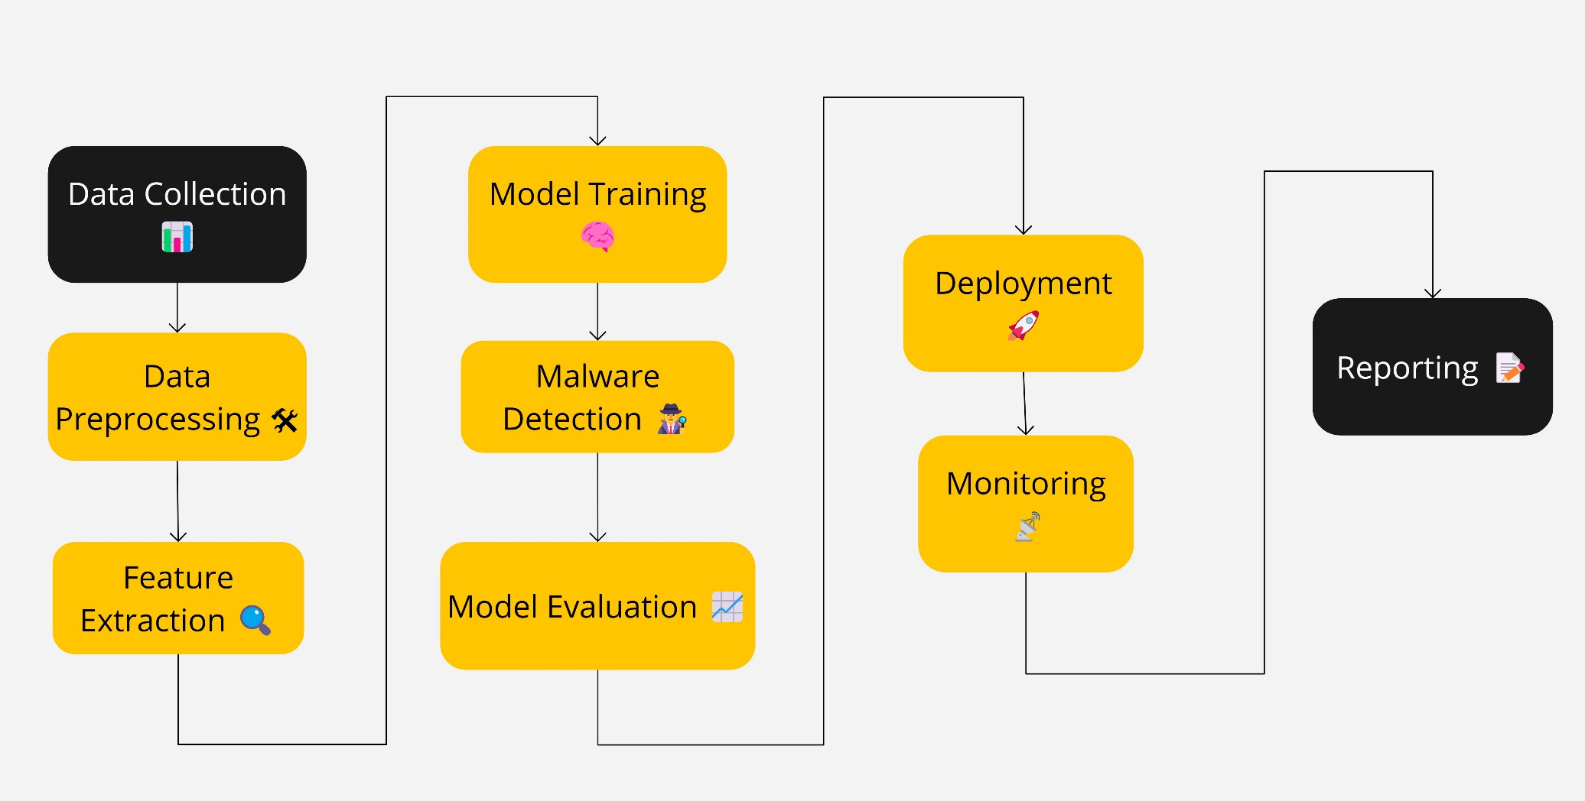
SYSYEM ARCHITECTURE

Slide 8
MODULES:
1. Data Collection and Preprocessing
2. Feature Extraction
3. Model Training
4. Anomaly Detection
5. Alert Generation and Reporting
6. Model Evaluation and Updating
7. User Interface and Visualization

Slide 9
Data Collection and Preprocessing
This module gathers transaction data from various sources, including financial institutions, e-commerce platforms, and user activity logs.
The collected data undergoes preprocessing steps such as cleaning, normalization, and transformation to ensure consistency and quality.

Slide 10
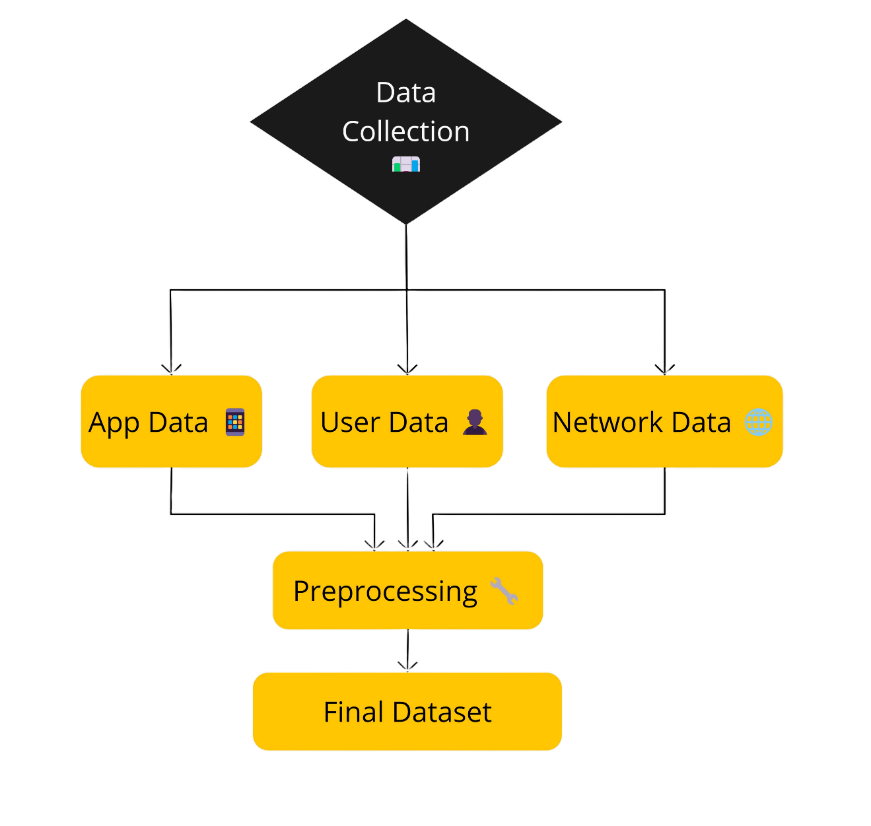
DATASET COLLECTION

Slide 11
Feature Extraction
Utilizing the convolutional layers of CNN, this module automatically extracts relevant features from the preprocessed transaction data.
These layers detect spatial hierarchies and patterns within the data, enabling the model to understand complex relationships and correlations.

Slide 12
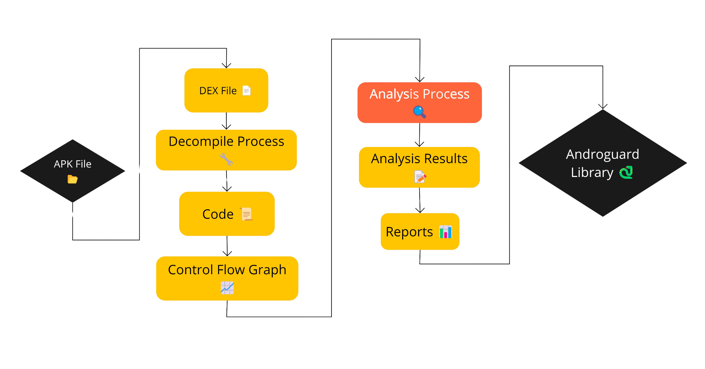
FEATURE EXTRACTION

Slide 13
Model Training
This module trains the CNN model using the extracted features.
The training process involves feeding the data through the network, adjusting weights using backpropagation, and optimizing the model parameters to minimize the loss function.
The model learns to differentiate between legitimate and fraudulent transactions.

Slide 14
Anomaly Detection
Once trained, the CNN model is deployed to monitor and analyze new transactions in real-time.
This module classifies transactions based on the learned patterns and identifies anomalies that deviate from typical behavior, flagging potential fraud.

Slide 15
Alert Generation and Reporting
When potential fraud is detected, this module generates alerts and reports for further investigation.
It provides detailed information about suspicious transactions, including the type of anomaly detected and the confidence score.

Slide 16
Model Evaluation and Updating
This module evaluates the performance of the CNN model using metrics such as accuracy, precision, recall, and F1-score.
It also incorporates feedback loops for continuous learning, updating the model with new data to improve detection capabilities and adapt to evolving fraud techniques.

Slide 17
User Interface and Visualization
This module provides a user-friendly interface for stakeholders to interact with the system. It includes visualizations of transaction data, fraud detection results, and system performance metrics, aiding in decision-making and analysis.
Key Functions: Dashboard creation, data visualization, user interaction, and report generation.

Slide 18
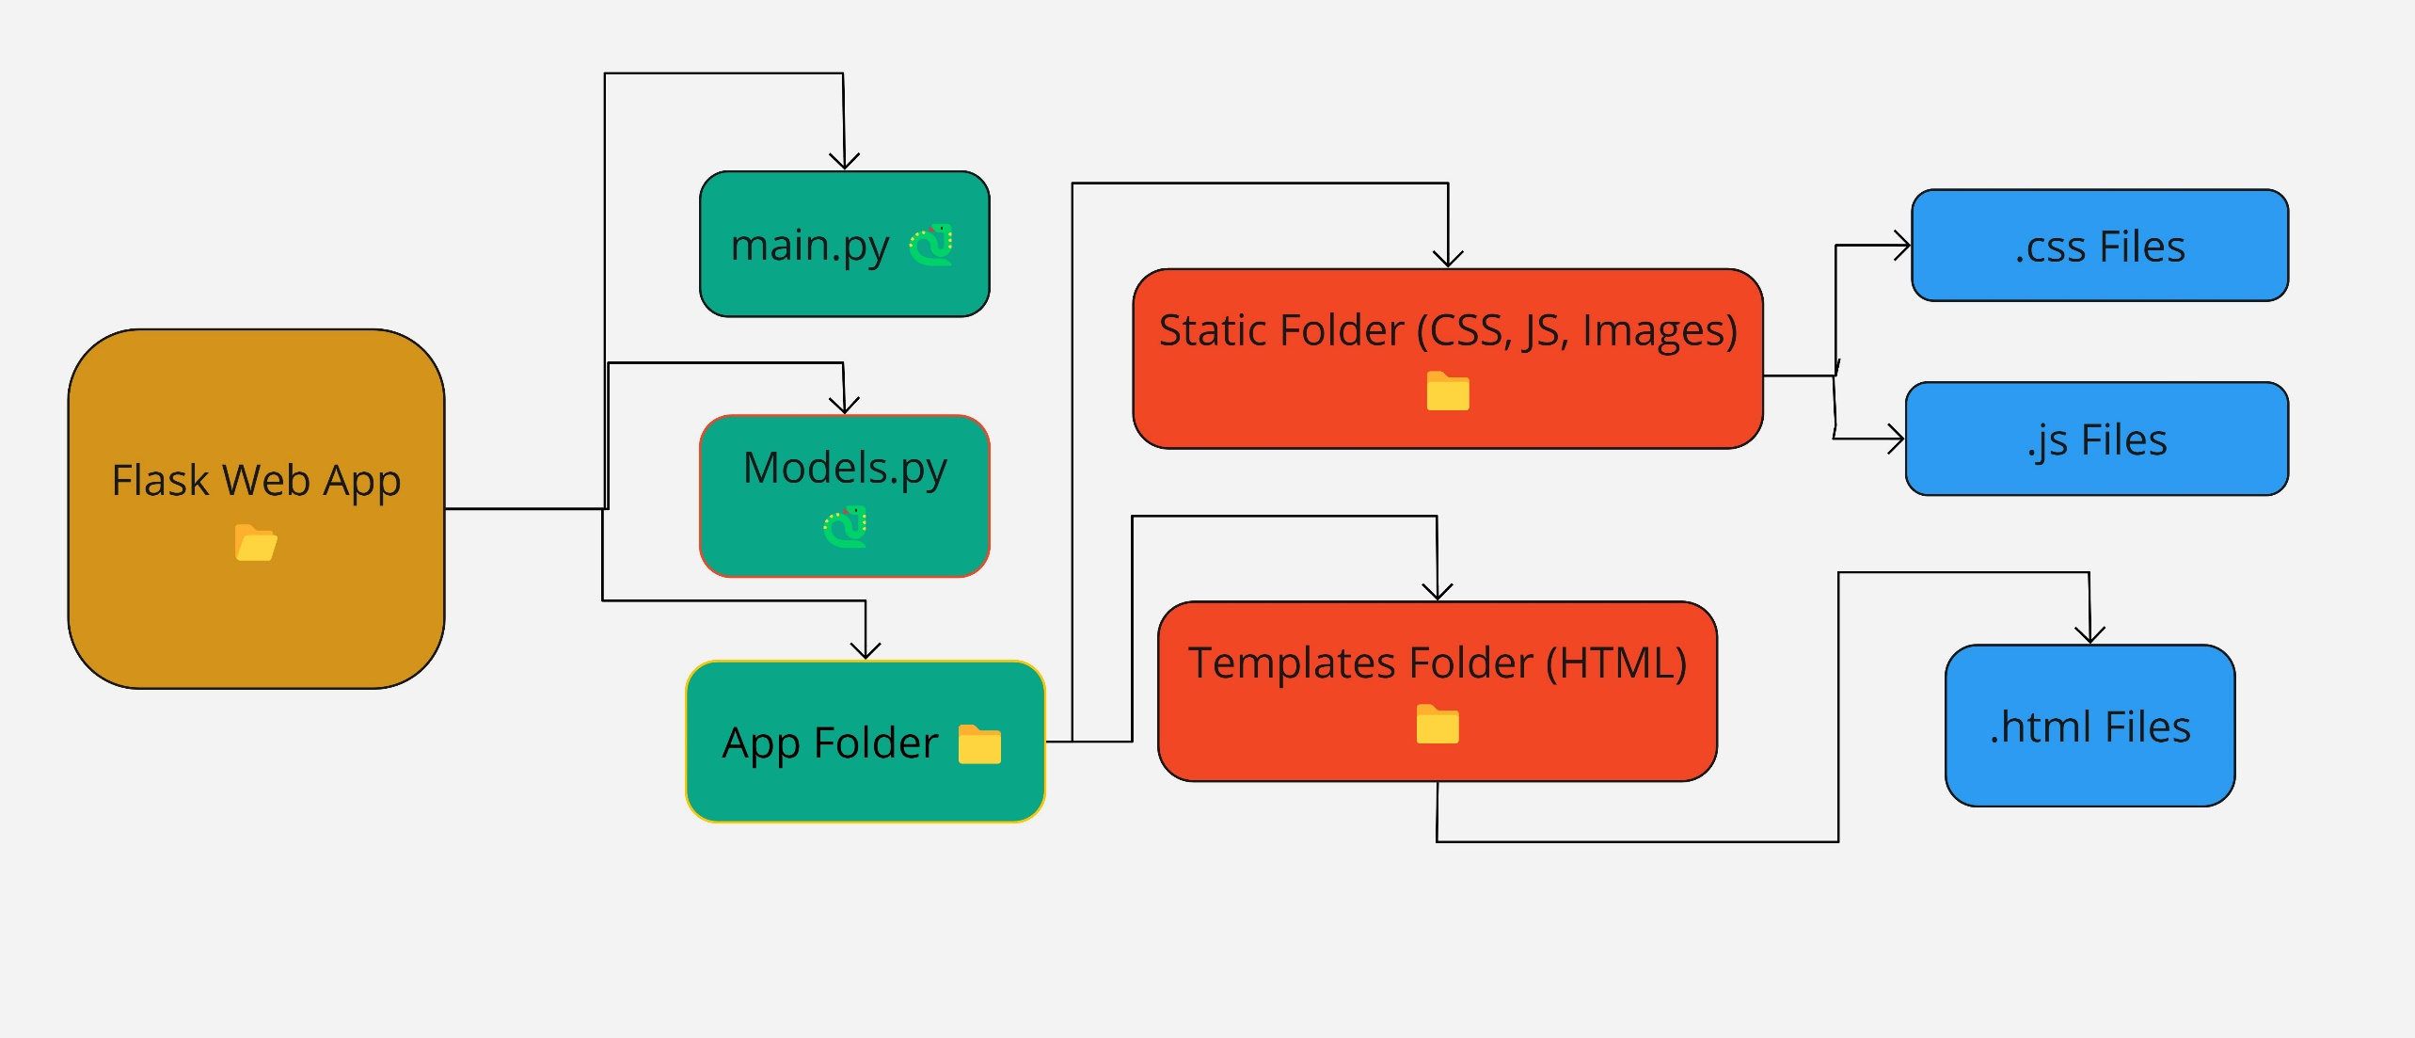
Flask based User Interface

Slide 19
ADVANTAGES:
Automatic Feature Extraction
Handling Complex and High-Dimensional Data
Adaptability to New Fraud Patterns
Improved Detection Accuracy
Real-Time Fraud Detection
Enhanced Security

Slide 20
CONCLUSION
In conclusion, leveraging Convolutional Neural Networks (CNNs) for cyber fraud detection and prevention represents a significant advancement in the fight against digital fraud.
CNNs offer a range of benefits, including automatic feature extraction, adaptability to new fraud patterns, and the ability to handle complex, high-dimensional data.
Their robust performance in real-time fraud detection and scalability makes them an ideal choice for modern cybersecurity challenges.
By continuously learning from data and improving over time, CNN-based systems provide enhanced accuracy, reduced false positives, and greater resilience against evolving threats.

Slide 21
REFERENCE
[1] credit card fraud, 2021. [Online]. Available: https://www.fbi.gov/scams and-safety/common-scams-and-crimes/credit-card-fraud
[2] General data protection regulation, 2021. Accessed: May 28, 2021. [On line]. Available: https://gdpr.eu/
[3] Pareto principle, 2021. Accessed: Jun. 6, 2021. [Online]. Available: https: //en.wikipedia.org/wiki/Pareto_principle
[4] romance dating scam, 2021. [Online]. Available: https://www.fbi.gov/ scams-and-safety/common-scams-and-crimes/romance-scams
[5] Why does fourth-party payment rise, and what is the charm of aggregate payment?,2021.Accessed:Jan.1,2021.[Online].Available:https://www. programmersought.com/article/52465472004/

Slide 22
THANK YOU

